Slide 1
Distributed Systems- II Dept. of Computer Science

Slide 2
Distributed Synchronization

Slide 3
MUTUAL EXCLUSION
Concurrent access of processes to a shared resource or data is executed in mutually exclusive manner.
Actions performed by a user on a shared resource must be atomic.
Only one process is allowed to execute the critical section (CS) at any given time.
In a distributed system, shared variables (semaphores) or a local kernel cannot be used to implement mutual exclusion.
Distributed mutual exclusion algorithms must deal with unpredictable message delays and incomplete knowledge of the system state.
Two basic approaches for distributed mutual exclusion:
1 Token based approach
2 Non-token based approach

Slide 4
Mutual Exclusion Algorithms
Non-token based:
Two or more successive rounds of messages exchanged
among the sites to determine which site will enter the CS
next
These algorithm are assertion based because a site
enters it’s CS when assertion defined on it’s local variable
becomes true
Token based:
A unique token (a known, unique message) is shared
among cooperating sites/processes.
Possessor of the token has access to critical section.
Mutual exclusion is ensured because the token is unique
Need to take care of conditions such as loss of token,
crash of token holder, possibility of multiple tokens, etc.

Slide 5
General System Model
At any instant, a site may have several requests for critical section (CS), queued up, and serviced one at a time.
Site States: Requesting CS, executing CS, idle (neither requesting nor executing CS).
The system consists of N sites, S1, S2, ..., SN.
We assume that a single process is running on each site. The process at site Si is denoted by pi .
A site can be in one of the following three states: requesting the CS, executing the CS, or neither requesting nor executing the CS (idle).
In the ‘requesting the CS’ state, the site is blocked and can not make further requests for the CS. In the ‘idle’ state, the site is executing outside the CS.
In token-based algorithms, a site can also be in a state where a site holding the token is executing outside the CS (called the idle token state).
At any instant, a site may have several pending requests for CS. A site queues up these requests and serves them one at a time

Slide 6
Mutual Exclusion: Requirements
The primary objective: to guarantee that only one request accesses the CS at a time.
Important Requirements of Mutual Exclusion Algorithms
- Safety Property: At any instant, only one process can
execute the critical section.
- Freedom from deadlock: Two or more sites should not
endlessly wait for messages that will never arrive.
- Freedom from Starvation: A site should not be forced to wait indefinitely to execute the CS while other sites repeatedly executing CS.
- Fairness: Each process gets a fair chance to execute the CS. Fairness property dictates that requests must be executed in the order they are arrive in the system. Time is determined by logical clock. Fairness implies freedom from starvation but not vice-versa.
- Fault Tolerance: Fault tolerant if in the wake of failure, it can recognize itself so that it continues to function without any disruptions.

Slide 7
Performance
The performance of mutual exclusion is generally measured by the following four metrics:
Message Complexity: Number of messages per CS invocation: should be minimized.
Synchronization delay, i.e., time between the leaving of CS by a site and the entry of CS by the next one: should be minimized.
Response time: time interval between request messages transmissions and exit of CS.
System throughput, i.e., rate at which system executes requests for CS: should be maximized.
If sd is synchronization delay, E the average CS execution time: system throughput = 1 / (sd + E).

Slide 8
Performance metrics
Next site
enters CS
Last site
exits CS
Synchronization
delay
Time
Messages
sent
CS Request
arrives
Enter CS
Exit CS
E
Time
Response Time

Slide 9
Low & High load Performance ...
We often study the performance of mutual exclusion algorithms under two special loading conditions, viz., “low load” and “high load”.
The load is determined by the arrival rate of requests.
Low and High Load:
Low load: No more than one request at a given point in time.
High load: Always a pending mutual exclusion request at a site.
Best and Worst Case: Coincide with low and high loads respectively. Mainly due to the response time differ in high and low load.
Best Case (low loads): Round-trip message delay + Execution time. 2T + E.
Worst case (high loads).
Message traffic: low at low loads, high at high loads.
Average performance: when load conditions fluctuate widely.

Slide 10
Simple Solution to Distributed mutual Exclusion
A site called control site, is assigned the task of granting permission for the CS execution.
To request the CS, a site sends a REQUEST message to the control site. The control site queues up the request for the CS and grants them permission one by one.
This method to achieve mutual exclusion requires only three messages per CS execution.
Drawback: single point of failure, control site heavily loaded, control site bottleneck, Synchronization delay is 2T because a site should first release permission to the control site and then the control site should grant permission to the next site to execute the CS.
System Throughput=1/(2T+E) due to synchronization delay. If synchronization delay reduced to T, the system throughput becomes almost double, 1/(T+E).

Slide 11
Solution hierarchy
Non Token based Token based algorithms
lamport’s algorithm Suzuki & Kasami
Ricart-Agrawala Singhal’s heuristic
Mackawa Raymond
Non Token based: A site communicates with a set of other sites to arbitrate who should execute the CS next. For a site Si, request set Ri contains id’s of all those sites from which site Si must acquire permission before entering the CS.
These algorithms use timestamp to order requests for the CS. Each request for the CS gets a timestamp, and a smaller timestamp request have priority over larger timestamp requests.

Slide 12
Non-token Based Algorithms
Notations:
Si: Site I
Ri: Request set, containing the ids of all Sis from which permission must be received before accessing CS.
Non-token based approaches use time stamps to order requests for CS.
Smaller time stamps get priority over larger ones.
Lamport’s Algorithm
Ri = {S1, S2, …, Sn}, i.e., all sites.
Request queue: maintained at each Si. Ordered by time stamps.
Assumption: message delivered in FIFO.

Slide 13
Lamport’s Algorithm
Requests for CS are executed in the increasing order of timestamps and time is determined by logical clocks.
Every site Si keeps a queue, request_queuei , which contains mutual exclusion requests ordered by their timestamps.
This algorithm requires communication channels to deliver messages the FIFO order.

Slide 14
Lamport’s Algorithm
Requesting CS:
When a site Si wants to enter the CS, it broadcasts a REQUEST(tsi , i ) message to all other sites and places the request on request_queuei . ((tsi , i ) denotes the timestamp of the request.)
When a site Sj receives the REQUEST(tsi , i ) message from site Si, it returns a timestamped REPLY message to Si and places site Si request on request_queuej.
Executing CS: Site Si enters the CS when the following two conditions hold:
- L1: Si has received a message with timestamp larger than (tsi , i ) from all other sites.
- L2: Si ’s request is at the top of request_queuei.

Slide 15
Releasing the critical section:
- Site Si , upon exiting the CS, removes its request from the top of its request queue and broadcasts a timestamped RELEASE message to all other sites.
- When a site Sj receives a RELEASE message from site Si , it removes Si ’s request from its request queue.
When a site removes a request from its request queue, its own request may come at the top of the queue, enabling it to enter the CS.

Slide 16
Lamport’s Algorithm…
Performance.
3(N-1) messages per CS invocation. (N - 1) REQUEST, (N - 1) REPLY, (N - 1) RELEASE messages.
Synchronization delay: T
Optimization
Lamport’s algorithm can be optimized to require between 3(N-1) and 2(N-1) messages per CS execution by suppressing REPLY messages in certain situations.
For example, if site Sj receives a REQUEST message from site Si after it has sent its own REQUEST message with timestamp higher than the timestamp of site Si ’s request, then site Sj need not send a REPLY message to site Si .
This is because when site Si receives site Sj ’s request with timestamp higher than its own, it can conclude that site Sj does not have any smaller timestamp request which is still pending.

Slide 17
Lamport’s Algorithm: Example
Step 1:
S1
(2,1)
S2
(1,2)
S3
Step 2:
S1
(1,2) (2,1)
S2 enters CS
S2
(1,2) (2,1)
S3
(1,2) (2,1)

Slide 18
Lamport’s: Example…
Step 3:
S1
(1,2) (2,1)
S2 leaves CS
S2
(1,2) (2,1)
S3
(1,2) (2,1)
Step 4:
S1
(1,2) (2,1)
(2,1)
S1 enters CS
S2
(1,2) (2,1)
(2,1)
S3
(1,2) (2,1)
(2,1)

Slide 19
Ricart-Agrawala Algorithm
The Ricart algorithm is an optimization of Lamport’s algorithm that dispenses with RELEASE message by cleverly merging them with REPLY messages.
Algorithm assumes the communication channels are FIFO. The algorithm uses two types of messages: REQUEST and REPLY.
A process sends a REQUEST message to all other processes to request their permission to enter the critical section. A process sends a REPLY message to a process to give its permission to that process.
Processes use Lamport-style logical clocks to assign a timestamp to critical section requests and timestamps are used to decide the priority of requests.
Each process Pi maintains the Request-Deferred array, RDi , the size of which is the same as the number of processes in the system.
Initially, ∀i ∀j : RDi [j]=0. Whenever Pi defer the request sent by Pj , it sets RDi [j]=1 and after it has sent a REPLY message to pj , it sets RDi [j]=0.

Slide 20
Ricart-Agrawala Algorithm
Requesting critical section
When a site Si wants to enter the CS, it broadcast a timestamped REQUEST message to all other sites.
When site Sj receives a REQUEST message from site Si, Sj sends REPLY to Si, if
Sj is not requesting nor executing CS
If Sj is requesting CS and Si’s time stamp is smaller than its own request.
Request is deferred otherwise and and Sj sets RDj [i]=1 .
Executing CS: after it has received REPLY from all sites in its request set.
Releasing CS: Send REPLY to all deferred requests. i.e., a site’s REPLY messages are blocked only by sites with smaller time stamps

Slide 21
Ricart-Agrawala: Performance
Notes:
A site’s REPLY message are blocked only by sites that are requesting the CS with higher priority (smaller timestamp)
When a site receives a message, it updates its clock using the timestamp in the message.
When a site takes up a request for the CS for processing, it updates its local clock and assigns a timestamp to the request.
Performance:
2(N-1) messages per CS execution. (N-1) REQUEST + (N-1) REPLY.
Synchronization delay: T.
.

Slide 22
Ricart-Agrawala: Optimization
Roucairol and Carvalho proposed an improvement to the Ricart-Agrawala by observing that once a site Si has received a REPLY message from a site Sj, the authorization will remain valid untill Si sends a Reply message to Sj(which happens only after the reception of REQUEST message from Sj).
Therefore after site Si has received a REPLY message from site Sj, site Si can enter its CS any number of times without requesting permission from site Sj until site Si sends a REPLY message to Sj.
Require 0 to 2(n-1) messages per CS.

Slide 23
Ricart-Agrawala: Example
Step 1:
S1
(2,1)
S2
(1,2)
S3
Step 2:
S1
S2 enters CS
S2
(2,1)
S3

Slide 24
Ricart-Agrawala: Example…
Step 3:
S1
S1 enters CS
S2
(2,1)
S2 leaves CS
S3

Slide 25
Maekawa’s Algorithm
A site requests permission only from a subset of sites.
Request set of sites si & sj: Ri, Rj such that Ri and Rj will have atleast one common site (Sk). Sk mediates conflicts between Ri and Rj.
A site can send only one REPLY message at a time, i.e., a site can send a REPLY message only after receiving a RELEASE message for the previous REPLY message.
Request Sets Rules:
Sets Ri and Rj have atleast one common site.
Si is always in Ri.
Cardinality of Ri, i.e., the number of sites in Ri is K.
Any site Si is in K number of Ris. N = K(K - 1) + 1 -> K = square root of N.

Slide 26
Maekawa’s Algorithm ...
Requesting CS
Site Si request to the CS by sending REQUEST(i) messages to all the sites in its request set Ri.
When a site Sj receives the REQUEST(i) message, it sends a REPLY message to Si provides it has’t sent a REPLY message to a site from the time it received the last release message.
Otherwise, queue up Si’s request for later consideration.
Executing CS: after getting REPLY from all sites in Ri.
Releasing CS
send RELEASE(i) to all sites in Ri
Any Sj after receiving RELEASE message, send REPLY message to the next request in queue.
If queue empty, update its state to reflect that the site has not sent out any REPLY message..

Slide 27
Maekawa’s Algorithm ...
Performance
Synchronization delay: 2T
Messages: 3 times square root of N (one each for REQUEST, REPLY, RELEASE messages)
Deadlocks
Message deliveries are not ordered.
Assume Si, Sj, Sk concurrently request CS
Ri intersection Rj = {Sij}, Rj Rk = {Sjk}, Rk Ri = {Ski}
Possible that:
Sij is locked by Si (forcing Sj to wait at Sij)
Sjk by Sj (forcing Sk to wait at Sjk)
Ski by Sk (forcing Si to wait at Ski)
-> deadlocks among Si, Sj, and Sk.

Slide 28
Token-based Algorithms
Unique token circulates among the participating sites.
A site can enter CS if it has the token.
Token-based approaches use sequence numbers instead of time stamps.
Request for a token contains a sequence number.
Sequence number of sites advance independently.
Correctness issue is trivial since only one token is present -> only one site can enter CS.
Deadlock and starvation issues to be addressed.

Slide 29
Suzuki-Kasami Algorithm
If a site without a token needs to enter a CS, broadcast a REQUEST for token message to all other sites.
The main design issues in this algorithm are (1): distinguishing outdated REQUEST message from current REQUEST messages (2): Determining which site has an outstanding request for the CS.
Token: (a) Queue of request sites (b) Array LN[1..N], the sequence number of the most recent execution by a site j.
Token holder sends token to requestor, if it is not inside CS. Otherwise, sends after exiting CS.
Token holder can make multiple CS accesses.
Design issues:
Distinguishing outdated REQUEST messages.
Format: REQUEST(j,n) -> jth site making nth request.
Each site has RNi[1..N] -> RNi[j] is the largest sequence number of request from j.
Determining which site has an outstanding token request.
If LN[j] = RNi[j] - 1, then Sj has an outstanding request.

Slide 30
Suzuki-Kasami Algorithm ...
Passing the token
After finishing CS
(assuming Si has token), LN[i] := RNi[i]
Token consists of Q and LN. Q is a queue of requesting sites.
Token holder checks if RNi[j] = LN[j] + 1. If so, place j in Q.
Send token to the site at head of Q.
Performance
0 to N messages per CS invocation.
Synchronization delay is 0 (if the token holder repeats CS) or T.

Slide 31
Suzuki-Kasami: Example
Step 1: S1 has token, S3 is in queue
Site Seq. Vector RN Token Vect. LN Token Queue
S1 10, 15, 9 10, 15, 8 3
S2 10, 16, 9
S3 10, 15, 9
Step 2: S3 gets token, S2 in queue
Site Seq. Vector RN Token Vect. LN Token Queue
S1 10, 16, 9
S2 10, 16, 9
S3 10, 16, 9 10, 15, 9 2
Step 3: S2 gets token, queue empty
Site Seq. Vector RN Token Vect. LN Token Queue
S1 10, 16, 9
S2 10, 16, 9 10, 16, 9 <empty>
S3 10, 16, 9

Slide 32
Singhal’s Heuristic Algorithm
Instead of broadcast: each site maintains information on other sites, guess the sites likely to have the token.
Data Structures:
Si maintains SVi[1..N] and SNi[1..N] for storing information on other sites: state and highest sequence number.
Token contains 2 arrays: TSV[1..N] and TSN[1..N].
States of a site
R : requesting CS
E : executing CS
H : Holding token, idle
N : None of the above
Initialization:
SVi[j] := N, for j = N .. i; SVi[j] := R, for j = i-1 .. 1; SNi[j] := 0, j = 1..N. S1 (Site 1) is in state H.
Token: TSV[j] := N & TSN[j] := 0, j = 1 .. N.

Slide 33
Singhal’s Heuristic Algorithm …
Requesting CS
If Si has no token and requests CS:
SVi[i] := R. SNi[i] := SNi[i] + 1.
Send REQUEST(i,sn) to sites Sj for which SVi[j] = R. (sn: sequence number, updated value of SNi[i]).
Receiving REQUEST(i,sn): if sn <= SNj[i], ignore. Otherwise, update SNj[i] and do:
SVj[j] = N -> SVj[i] := R.
SVj[j] = R -> If SVj[i] != R, set it to R & send REQUEST(j,SNj[j]) to Si. Else do nothing.
SVj[j] = E -> SVj[i] := R.
SVj[j] = H -> SVj[i] := R, TSV[i] := R, TSN[i] := sn, SVj[j] = N. Send token to Si.
Executing CS: after getting token. Set SVi[i] := E.

Slide 34
Singhal’s Heuristic Algorithm …
Releasing CS
SVi[i] := N, TSV[i] := N. Then, do:
For other Sj: if (SNi[j] > TSN[j]), then {TSV[j] := SVi[j]; TSN[j] := SNi[j]}
else {SVi[j] := TSV[j]; SNi[j] := TSN[j]}
If SVi[j] = N, for all j, then set SVi[i] := H. Else send token to a site Sj provided SVi[j] = R.
Fairness of algorithm will depend on choice of Si, since no queue is maintained in token.
Arbitration rules to ensure fairness used.
Performance
Low to moderate loads: average of N/2 messages.
High loads: N messages (all sites request CS).
Synchronization delay: T.

Slide 35
Singhal: Example
Assume there are 3 sites in the system. Initially:
Site 1: SV1[1] = H, SV1[2] = N, SV1[3] = N. SN1[1], SN1[2], SN1[3] are 0.
Site 2: SV2[1] = R, SV2[2] = N, SV2[3] = N. SNs are 0.
Site 3: SV3[1] = R, SV3[2] = R, SV3[3] = N. SNs are 0.
Token: TSVs are N. TSNs are 0.
Assume site 2 is requesting token.
S2 sets SV2[2] = R, SN2[2] = 1.
S2 sends REQUEST(2,1) to S1 (since only S1 is set to R in SV[2])
S1 receives the REQUEST. Accepts the REQUEST since SN1[2] is smaller than
the message sequence number.
Since SV1[1] is H: SV1[2] = R, TSV[2] = R, TSN[2] = 1, SV1[1] = N.
Send token to S2
S2 receives the token. SV2[2] = E. After exiting the CS, SV2[2] = TSV[2] = N.
Updates SN, SV, TSN, TSV. Since nobody is REQUESTing, SV2[2] = H.
Assume S3 makes a REQUEST now. It will be sent to both S1 and S2. Only S2
responds since only SV2[2] is H (SV1[1] is N now).

Slide 36
Raymond’s Algorithm
Sites are arranged in a logical directed tree. Root: token holder. Edges: directed towards root.
Every site has a variable holder that points to an immediate neighbor node, on the directed path towards root. (Root’s holder point to itself).
Requesting CS
If Si does not hold token and request CS, sends REQUEST upwards provided its request_q is empty. It then adds its request to request_q.
Non-empty request_q -> REQUEST message for top entry in q (if not done before).
Site on path to root receiving REQUEST -> propagate it up, if its request_q is empty. Add request to request_q.
Root on receiving REQUEST -> send token to the site that forwarded the message. Set holder to that forwarding site.
Any Si receiving token -> delete top entry from request_q, send token to that site, set holder to point to it. If request_q is non-empty now, send REQUEST message to the holder site.

Slide 37
Raymond’s Algorithm …
Executing CS: getting token with the site at the top of request_q. Delete top of request_q, enter CS.
Releasing CS
If request_q is non-empty, delete top entry from q, send token to that site, set holder to that site.
If request_q is non-empty now, send REQUEST message to the holder site.
Performance
Average messages: O(log N) as average distance between 2 nodes in the tree is O(log N).
Synchronization delay: (T log N) / 2, as average distance between 2 sites to successively execute CS is (log N) / 2.
Greedy approach: Intermediate site getting the token may enter CS instead of forwarding it down. Affects fairness, may cause starvation.

Slide 38
Raymond’s Algorithm: Example
Step 1:
Token
holder
S1
S2
Token
request
S3
S4
S5
S6
S7
Step 2:
S1
S2
Token
S3
S4
S5
S6
S7

Slide 39
Raymond’s Algm.: Example…
Step 3:
S1
S2
S3
S4
S5
S6
S7
Token
holder

Slide 40
Comparison
Non-Token Resp. Time(ll) Sync. Delay Messages(ll) Messages(hl)
Lamport 2T+E T 3(N-1) 3(N-1)
Ricart-Agrawala 2T+E T 2(N-1) 2(N-1)
Maekawa 2T+E 2T 3*sq.rt(N) 5*sq.rt(N)
Token Resp. Time(ll) Sync. Delay Messages(ll) Messages(hl)
Suzuki-Kasami 2T+E T N N
Singhal 2T+E T N/2 N
Raymond T(log N)+E Tlog(N)/2 log(N) 4

Slide 41
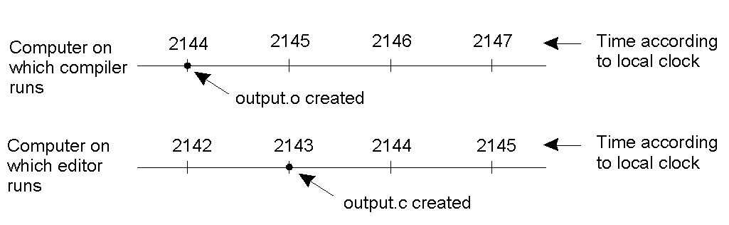
Clock Synchronization
When each machine has its own clock, an event that occurred after another event may nevertheless be assigned an earlier time.

Slide 42
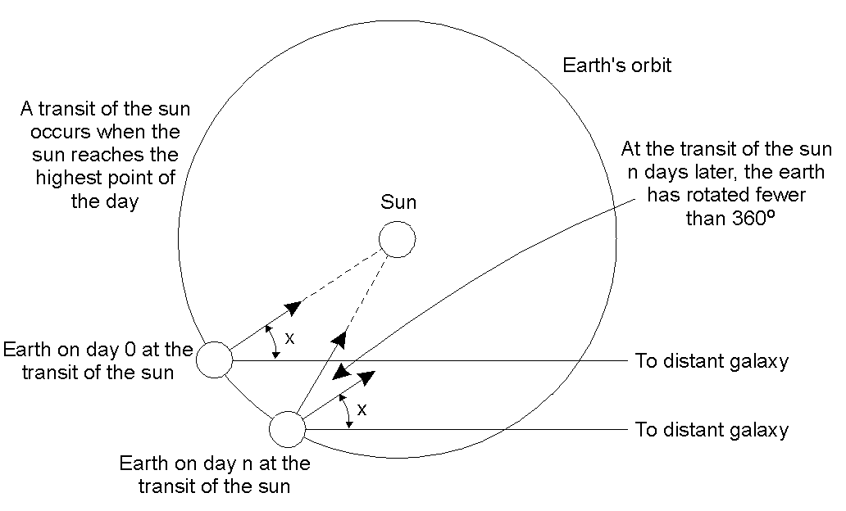
Physical Clocks (1)
Computation of the mean solar day.

Slide 43
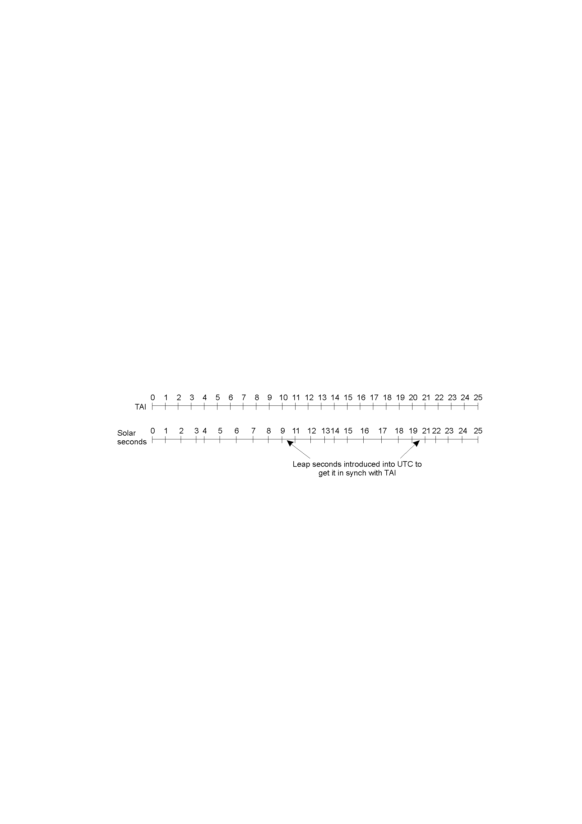
Physical Clocks (2)
TAI seconds are of constant length, unlike solar seconds. Leap seconds are introduced when necessary to keep in phase with the sun.

Slide 44
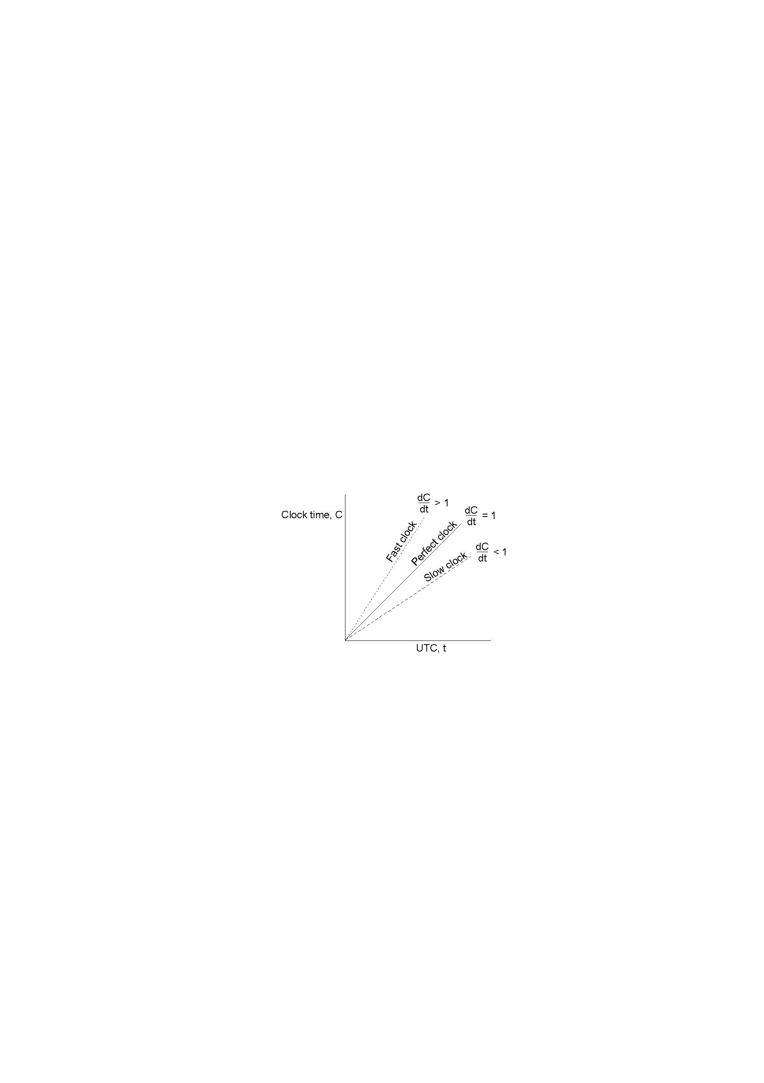
Clock Synchronization Algorithms
The relation between clock time and UTC when clocks tick at different rates.

Slide 45
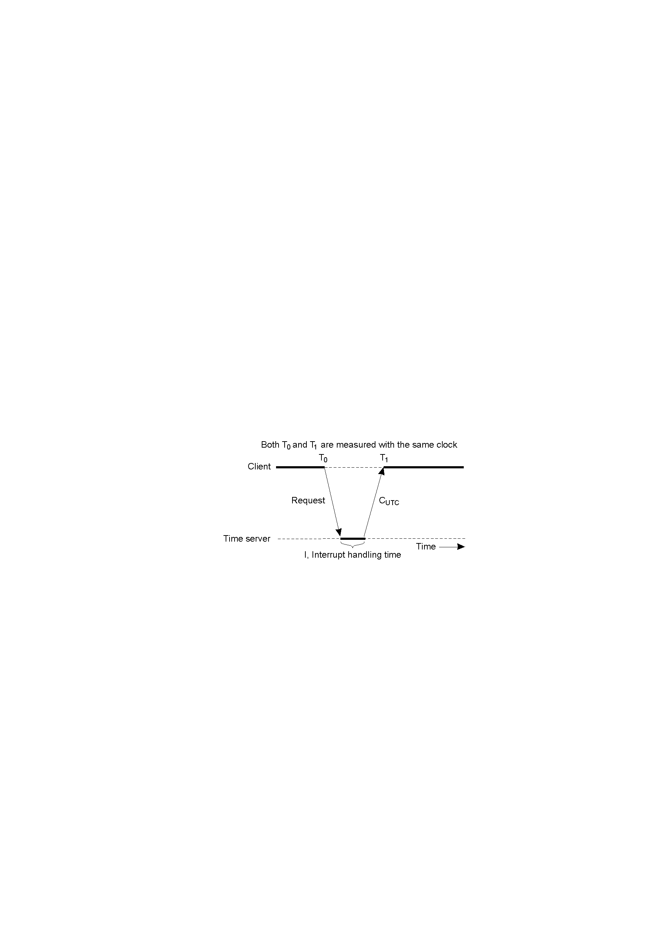
Cristian's Algorithm
Getting the current time from a time server.

Slide 46
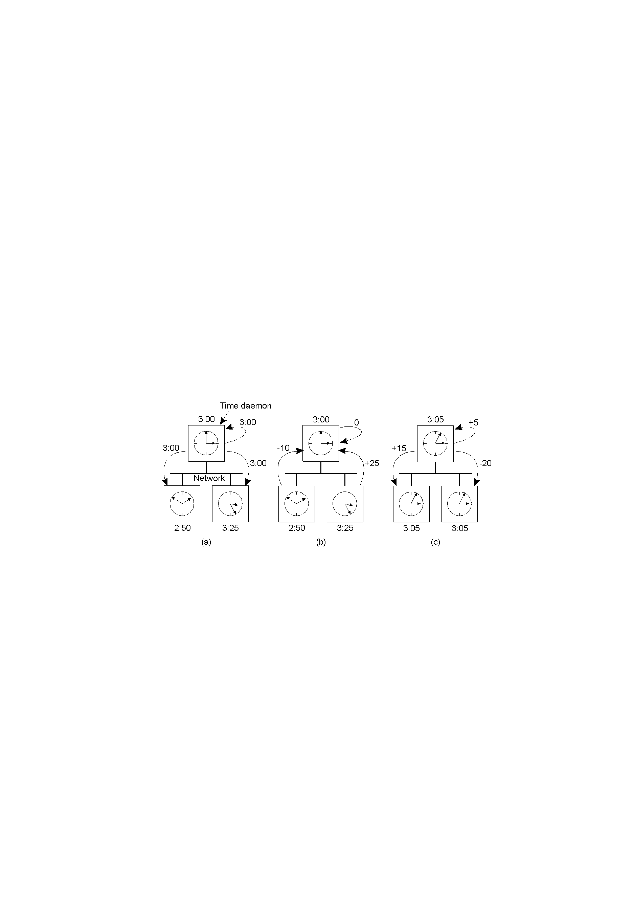
The Berkeley Algorithm
The time daemon asks all the other machines for their clock values
The machines answer
The time daemon tells everyone how to adjust their clock

Slide 47
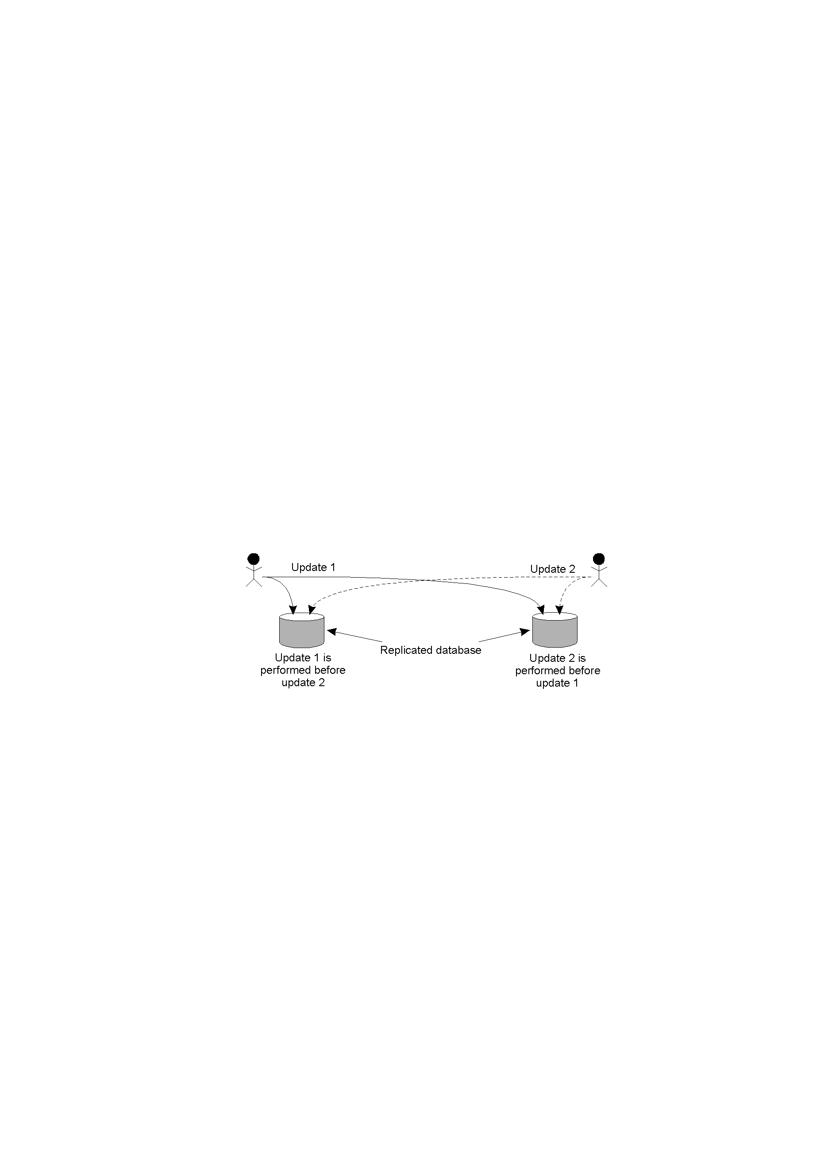
Lamport Timestamps
Three processes, each with its own clock. The clocks run at different rates.
Lamport's algorithm corrects the clocks.

Slide 48
Example: Totally-Ordered Multicasting
Updating a replicated database and leaving it in an inconsistent state.

Slide 49
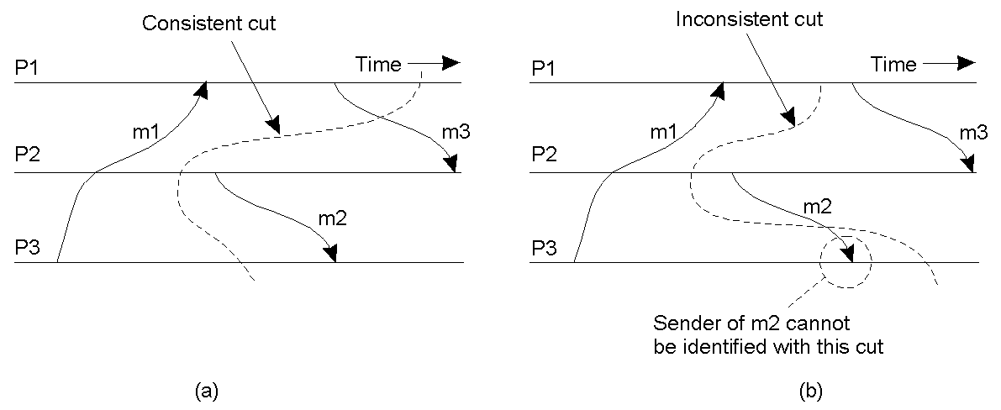
Global State (1)
A consistent cut
An inconsistent cut

Slide 50
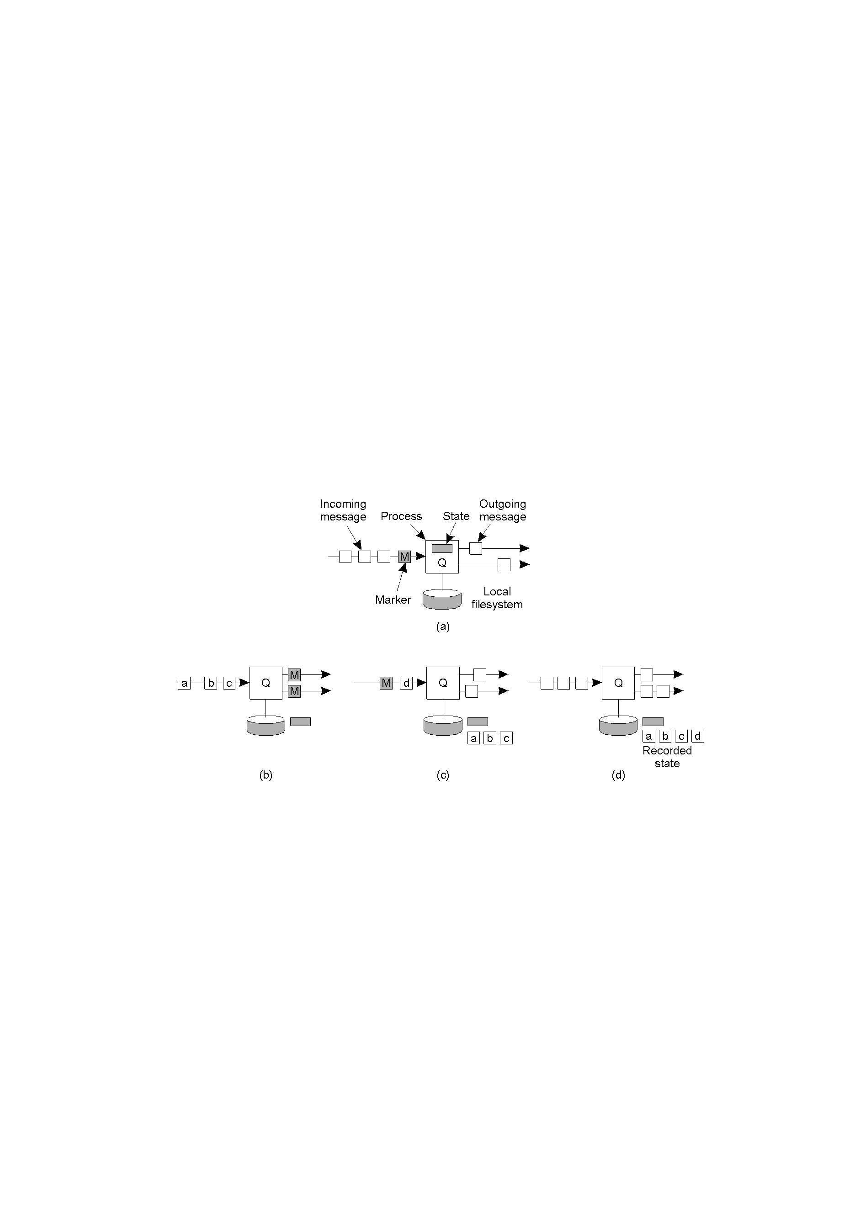
Global State (2)
Organization of a process and channels for a distributed snapshot

Slide 51
Global State (3)
Process Q receives a marker for the first time and records its local state
Q records all incoming message
Q receives a marker for its incoming channel and finishes recording the state of the incoming channel

Slide 52
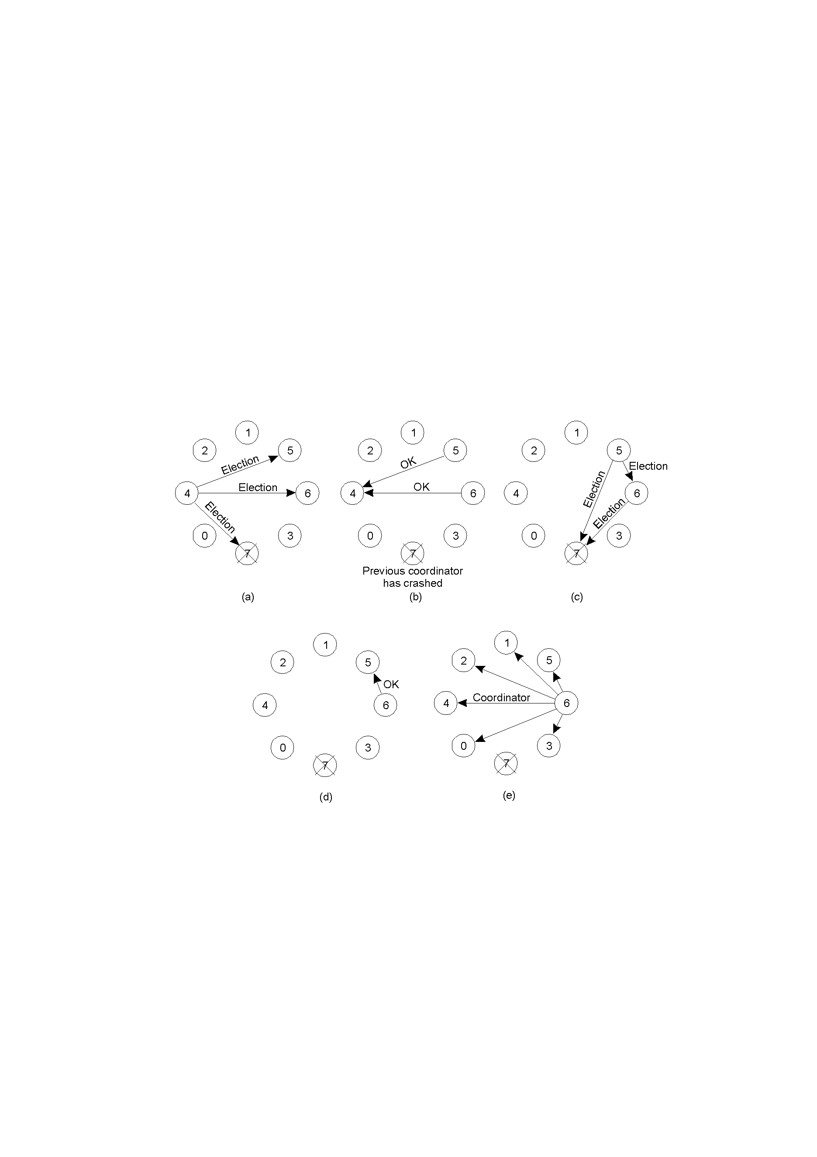
The Bully Algorithm (1)
The bully election algorithm
Process 4 holds an election
Process 5 and 6 respond, telling 4 to stop
Now 5 and 6 each hold an election

Slide 53
Global State (3)
Process 6 tells 5 to stop
Process 6 wins and tells everyone

Slide 54
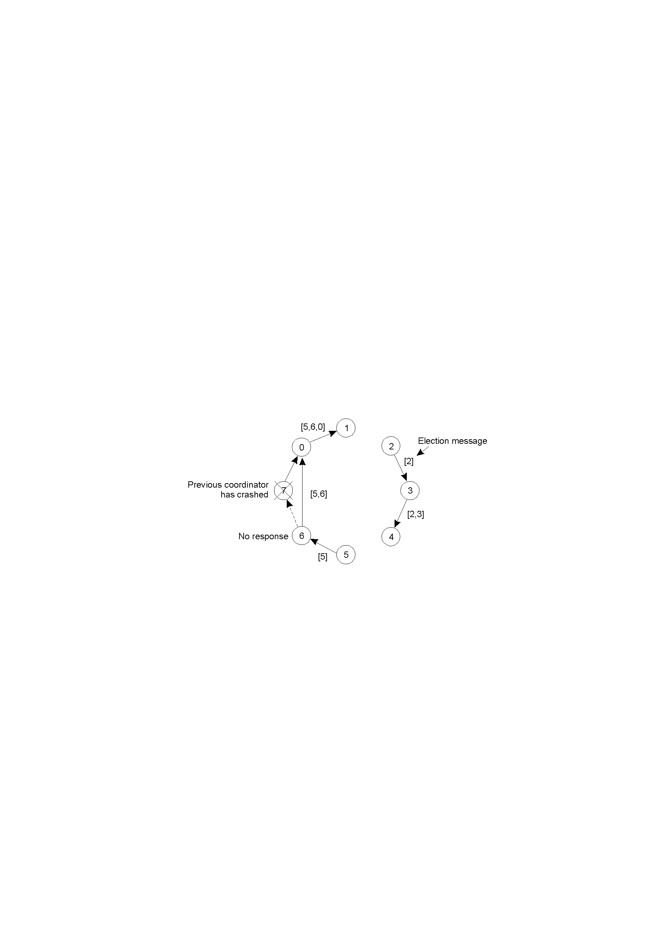
A Ring Algorithm
Election algorithm using a ring.

Slide 55
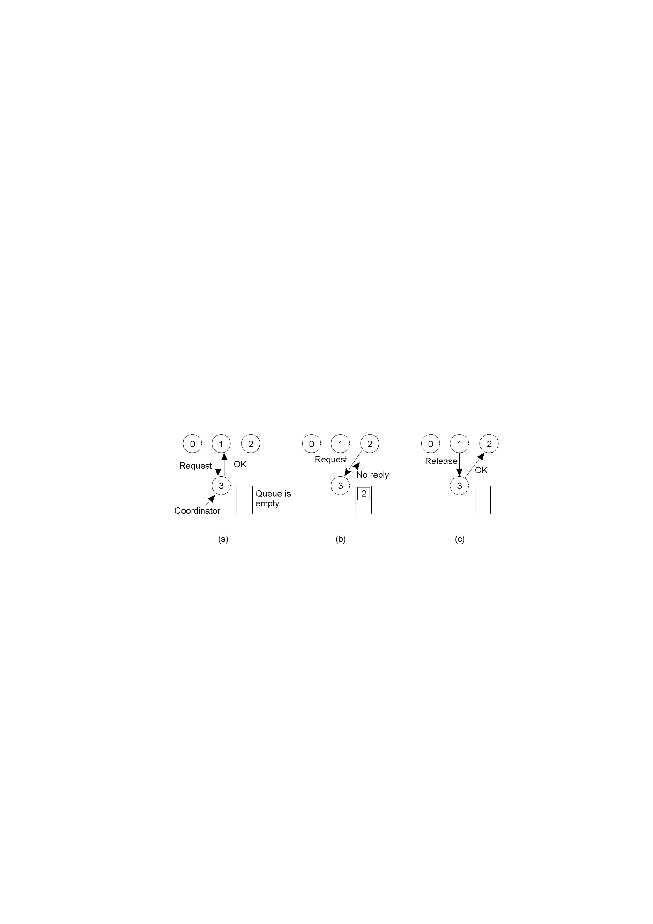
Mutual Exclusion: A Centralized Algorithm
Process 1 asks the coordinator for permission to enter a critical region. Permission is granted
Process 2 then asks permission to enter the same critical region. The coordinator does not reply.
When process 1 exits the critical region, it tells the coordinator, when then replies to 2

Slide 56
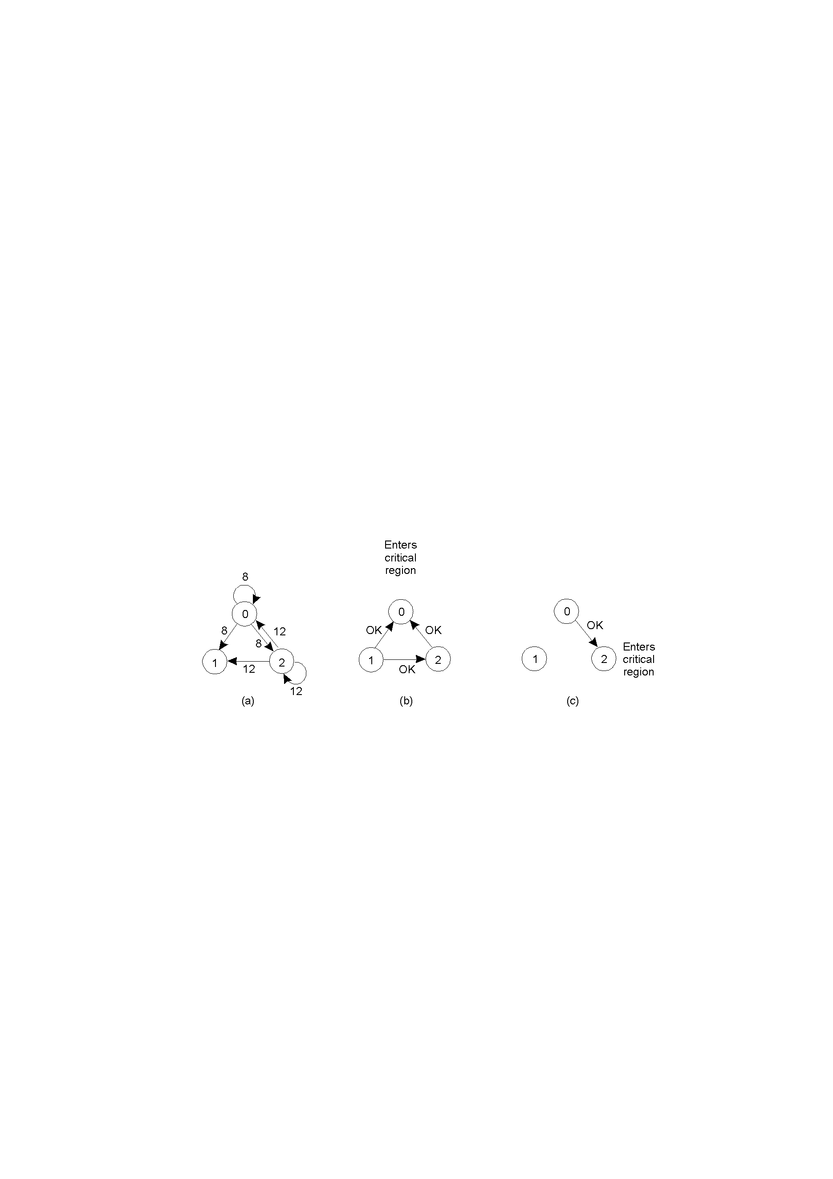
A Distributed Algorithm
Two processes want to enter the same critical region at the same moment.
Process 0 has the lowest timestamp, so it wins.
When process 0 is done, it sends an OK also, so 2 can now enter the critical region.

Slide 57
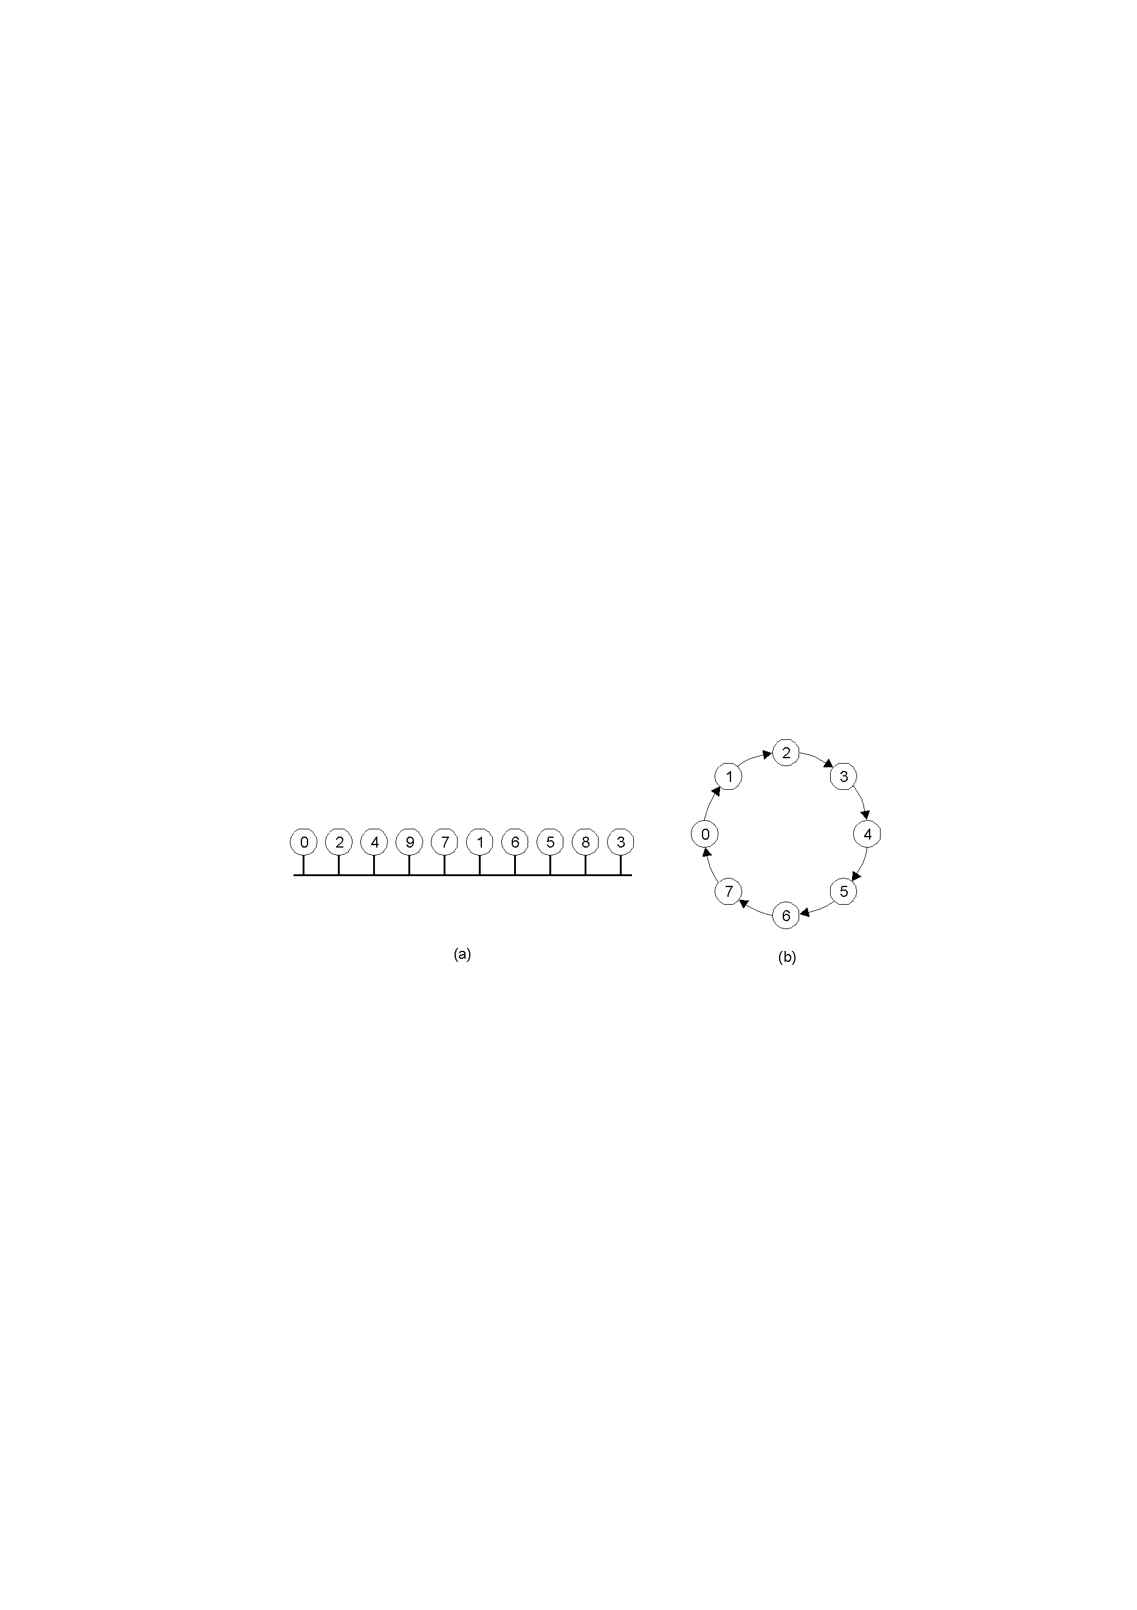
A Token Ring Algorithm
An unordered group of processes on a network.
A logical ring constructed in software.

Slide 58
Comparison
Algorithm | Messages per entry/exit | Delay before entry (in message times) | Problems
Centralized | 3 | 2 | Coordinator crash
Distributed | 2 ( n – 1 ) | 2 ( n – 1 ) | Crash of any process
Token ring | 1 to ∞ | 0 to n – 1 | Lost token, process crash
A comparison of three mutual exclusion algorithms.

